Slide 1
Sentiment Analysis of E-Commerce Product Reviews
Presented By
Vivek Rajput

Slide 2
Abstract
Most consumers rely on online reviews when deciding to purchase e-commerce services or products. Unfortunately, the main problem of these reviews, which is not completely tackled, is the existence of deceptive reviews. The novelty of the proposed system is the application of opinion mining on consumers’ reviews to help businesses and organizations continually improve their market strategies and obtain an in-depth analysis of the consumers’ opinions regarding their products and brands. In this paper, the long short-term memory (LSTM) and deep learning convolutional neural network integrated with LSTM (CNN-LSTM) models were used for sentiment analysis of reviews in the e-commerce domain. The system was tested and evaluated by using real-time data that included reviews of cameras, laptops, mobile phones, tablets, televisions, and video surveillance products from the Amazon website. Data preprocessing steps, such as lowercase processing, stopword removal, punctuation removal, and tokenization, were used for data cleaning. The clean data were processed with the LSTM and CNN-LSTM models for the detection and classification of the consumers’ sentiment into positive or negative. The LSTM and CNN-LSTM algorithms achieved an accuracy of 94% and 91%, respectively. We conclude that the deep learning techniques applied here provide optimal results for the classification of the customers’ sentiment toward the products.

Slide 3
The main contributions of the proposed research are the following:
(1)The generation of a sentiment score using a lexicon-based approach for each product review of the dataset.
(2)Labeling the review texts as negative if the generated sentiment score is <0 or positive if the score is >1.
(3)The combination of all product reviews into a single data frame to obtain more sentiment-related words.
(4)Improving the accuracy by developing a hybrid deep learning model combining the CNN and LSTM models for the product-related sentiment classification.
(5)Comparing the classification performance of the CNN-LSTM and LSTM models.

Slide 4
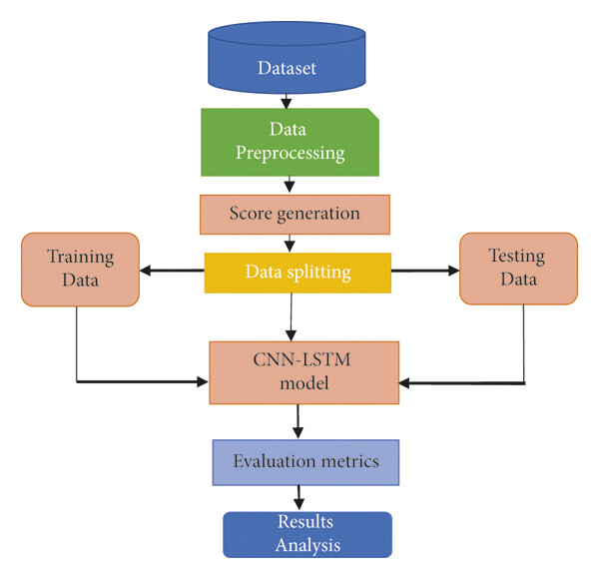
Materials and Methods
The proposed methodology for predicting the review-related sentiments is based on the deep learning algorithms presented here. The phases of the proposed system are the following: dataset collection, data preprocessing, generating the sentiment score, polarity calculation, applying the CNN-LSTM model, evaluation metrics, and analysis of the results. Figure 1 shows the framework of the proposed methodology used in the present study.

Slide 5
Data Preprocessing
We implemented different preprocessing steps aiming at cleaning the review texts so that they are easy to process. The following preprocessing methods were performed on the dataset as a whole.
Lowercase
It entails converting whole words of the review text into lowercase words.
Stop word Removal
Stop words are widely used words in a language, such as “the,” “a,” “an,” “is,” and “are”. As these words do not carry any information significant for the model, they were removed from the content of the review.
Punctuation Removal
All punctuation marks in the review texts were removed.
One-Word Review Elimination
Reviews that included only one word were eliminated.

Slide 6
Contraction Removal
This process replaces a word originally written in the short form with the respective full form; for instance, “when’ve” becomes “when have.”
Tokenization
Each sentence of the review texts was divided into small pieces of words or tokens.
Part-of-Speech Tagging
This step is used to tag each word present in the sentence with a POS tag, for example, “VB” for a verb, “AJJ” for an adjective, and “NN” for a noun.
Score Generation
The review text was evaluated for sentiment, and a score was generated. For calculating the sentiment score, the dataset was matched with opinion lexicon that consists of 5,000 positive words and 4,500 negative words with their respective scores. The sentiment score was calculated for each review text based on the scores of the lexicon. The review text was labeled as positive if the score was >0; otherwise, it was labeled as negative.

Slide 7
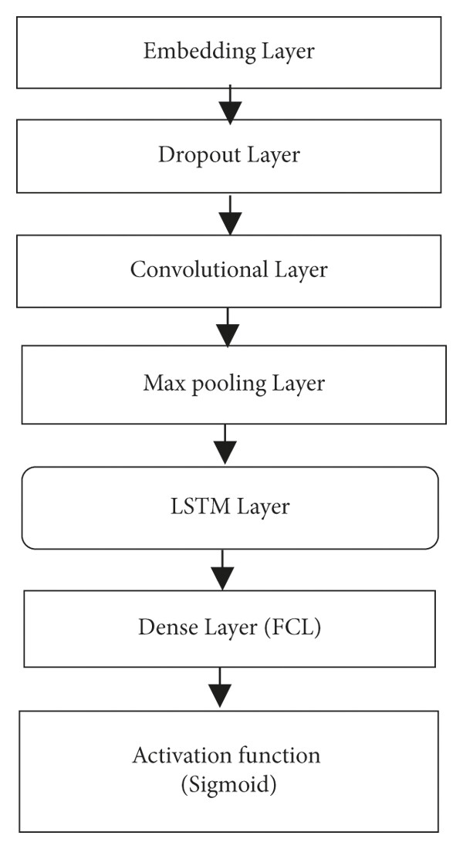
The CNN-LSTM Model
Figure presents the structure of the CNN-LSTM model used for sentiment classification of customers’ reviews using an Amazon dataset.
Embedding Layer
This is the initial layer of the CNN-LSTM model that is used to transform each word in the training dataset into an actual-valued vector, meaning that a set of sentiment-related words are constructed and transformed into a numerical form. This process is known as word embedding. The embedding layer consisted of three components: the vocabulary size (maximum features; 15,000 words), the embedding dimensions (50), and the input sequence length (400 words).

Slide 8
Dropout Layer
The main task of this layer is to avoid the over fitting of the model. Here, we assigned the value 0.4 to the dropout rate parameter, where this value has a range between 0 and 1. The main function of the dropout layer is to arbitrarily deactivate a set of neurons in the embedding layer, where every neuron denotes the dense exemplification of a sentiment word in a review text.
CNN is a deep learning technique used in different areas such as natural language preprocessing tasks, computer vision, and medical image processing.
Convolution Layer
The third layer of the CNN-LSTM model is used for the extraction of features from the input matrix. It uses n convolution filters that operate over the elements of the input sequence matrix to find the convolutions for each sequence. We set the number of filters to 64 and the size of the filter kernel to 3 × 3.
Max Pooling Layer
This layer performs down sampling beside the spatial dimensionality of the given input sequences. It considers the maximum value of all input features in the pool of each filter kernel. It has assigned to 5 × 5 kernel.

Slide 9

Dense Layer (Fully Connected Layer)
This is a hidden layer in the CNN-LSTM model. It consists of 512 artificial connected neurons that connect all neurons of the network. The function applied to this layer is the rectified linear unit described by the following equation:
Sigmoid Activation Function
It is the first layer that detects and classifies the output classes (positive or negative sentiment). The sigmoid function formula is given as follows (Algorithm 1):

Slide 10
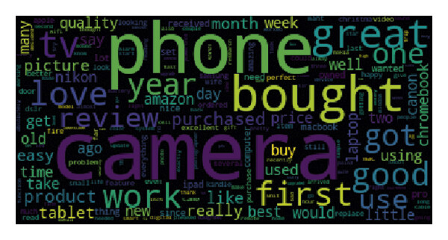
Experimental Results
In this section, we present the experimental results of the application of the CNN-LSTM and LSTM models for the analysis and prediction of sentiment in the e-commerce domain. We used hardware with 4 GB RAM and an i7 2800 CPU and ran the experiments on the Jupyter environment. The evaluation metrics (accuracy, precision, F1-score, recall, and specificity) were employed to examine the proposed system. The word cloud (sentiment words and product names) of the dataset is presented in Figure 4, which shows graphical representations of words (large font words) that give greater importance to that seem more repeatedly in the used product review dataset.

Slide 11
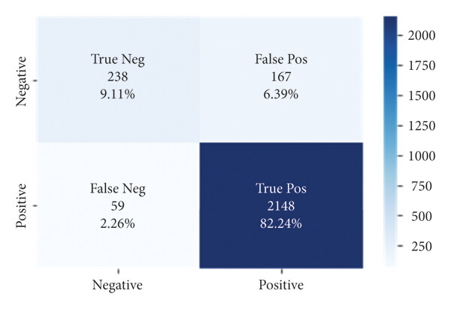
The confusion matrix of the CNN-LSTM and LSTM models is shown in Figure 5. The confusion matrix is used to present the rates of TP, FP, TN, and FN of the sample. Based on these rates, the evaluation metrics (specificity, accuracy, recall, precision, and F1-score) were calculated to evaluate the CNN-LSTM model using unseen data to predict the sentiment of customers. LSTM resulted in 82.24% TP, while CNN-LSTM resulted in 83.54% TP. As for misclassification, LSTM resulted in 6.39% FP and CNN-LSTM in 5.28% FP, indicating that the CNN-LSTM model was slightly better than the LSTM model.

Slide 12
Conclusion
Recently, sentiment analysis has become a valuable tool for the generation and evaluation of different types of data, helping the decision-making processes that lead to the improvement of businesses and companies. Social networking creates a large amount of data that require processing and analysis to obtain relevant insights. In the present study, the experimental dataset was collected from the Amazon website and included reviews of laptops, mobile phones, tablets, televisions, and video surveillance products. The lexicon-based approach was used for the calculation of the sentiment score for each review text. The output of the preprocessed data was classified with the LSTM and CNN-LSTM models. The experimental results showed that our model was satisfactory in all the measurement metrics.

Slide 13
Thank You

